Slide 1
Introducing Blackboard Ally to Students

Slide 2
Slide Deck Instructions
This slide is for instructors to share with students on the availability of Ally’s alternative formats.
Ideal use case for this slide deck would be during first day of class and then perhaps other times throughout the semester.
Any text that is highlighted in yellow should be filled in accordingly.

Slide 3

What is Ally?
Ally is a digital accessibility tool embedded in <insert your Learning Management System name here>, designed to help make digital course content more accessible and inclusive.

Slide 4

Ally for Students
Ally provides all students access to more accessible alternatives of instructor-uploaded or created content, such as HTML, ePUb, Tagged PDF, Audio, Electronic Braille, and more. This allows you to choose the format that works best for your personal preference.
No extra approvals or requests are needed to access the alternative formats and there is no limit to the number of times you download.
Student anonymity is protected-instructors have no what.

Slide 5
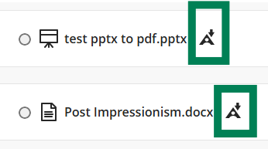
How to Access the Alternative Formats
Look for the Alternative Formats icon to the right of your course content. Once you select the icon, a menu of available alternative formats based on the original content will appear. Select your desired alternative format and then download.
The Alternative Formats icon can vary by LMS, but it generally appears as a downward-pointing arrow.
If you don't see an Alternative Formats icon next to a piece of content, Ally may not be enabled for that content or the file type may not support Alternative Formats.

Slide 6
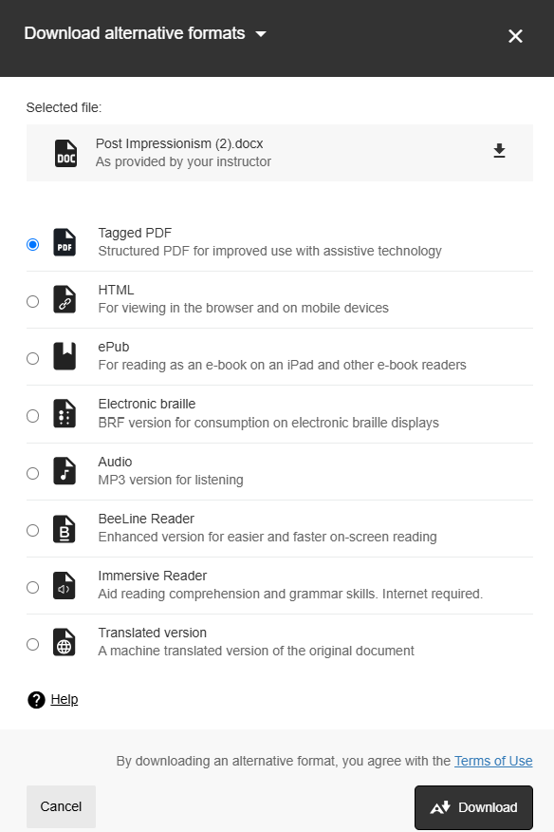
Downloading Alternative Formats
After you’ve selected the content item you wish to download an alternative format for, you will be brought to a menu of available options.
Select the alternative format you wish to download and then select download.

Slide 7
Alternative Format Options
Optical Character Recognition (OCR) PDF
Tagged PDF
Audio
HTML
OCR converts digital images, like scanned PDFs, into searchable text compatible with assistive technology.
Tags identify the purpose and structure of content, such as headings, paragraphs, block quotes, lists, and tables.
MP3 of an original file, includes semantic structure (i.e. tags, alt text ).
Web page version of a file that is responsive to screen size.

Slide 8
Alternative Format Options Continued…
ePub
BeeLine Reader
Braille Ready Format
Translation Versions
Digital file format for eReaders, allowing customization of font, size, and layout . Also allows for bookmarking, annotating, and highlighting text.
Software system that applies color gradients to digital text to improve reading, the ability to focus, and reducing eye strain.
Electronic, tactile text file for exclusive use with electronic braille displays or braille software programs.
Machine-translated HTML version of the instructor's original item in over 70 different languages.

Slide 9
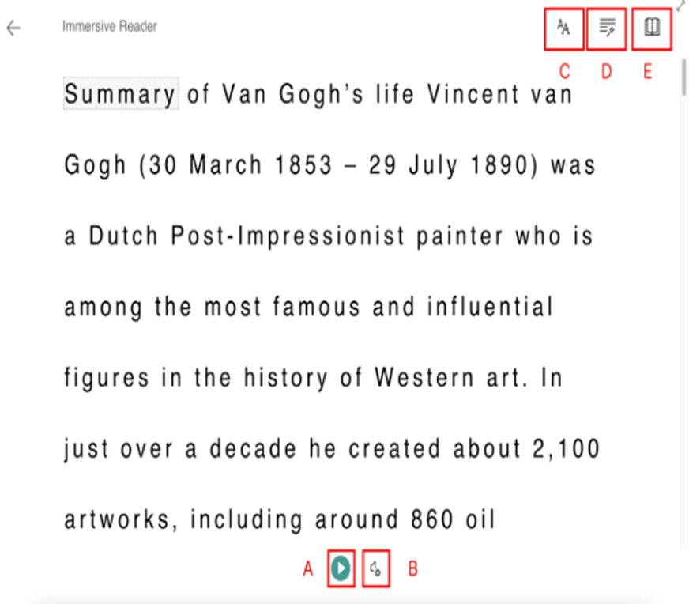
Microsoft Immersive Reader (additional alt format option)
Interactive reading comprehension and learning tool.
Text-to-speech feature, can also change voice selection and voice speed.
Can divide words into syllables and highlight parts of speech (e.g. nouns and verbs).

Slide 10
Student Use Cases of Alternative Formats

Slide 11
Use Case #1: Mobile Device
Use case description: Students who frequently use smartphones or tablets to access course materials.
Suggested Alternative Formats:
  HTML: responsive to screen size, no need to pinch or zoom, can be downloaded and then later accessed in offline capacity.
  Audio files: to listen to content while studying or even on the go, such as while commuting or exercising.

Slide 12
Use Case #2: Students with a Vision Impairment
Use Case Description: Student with vision impairment that relies on assistive technology to access digital course content
Assistive technology could be a screen reader, text to speech, screen magnifier, refreshable Braille display, etc.
Suggested alternative formats:
  Audio files
  ePub: can access text to speech functionality and/or customize the display (i.e. increase font size, change background color, etc.)
  Braille Ready File: used exclusively with a refreshable Braille display
  Tagged PDF: used with a screen reader, provides structure and semantic context to PDF
  Microsoft Immersive Reader: customize display of text or even utilize text to speech
  BeeLine Reader: color gradients applied to text are proven to reduce eye strain

Slide 13
Use Case #3: Students on the Go
Use Case description: Students who commute for work or school, juggle multiple responsibilities (i.e. caregiving and studying) and need to maximize time, students who exercise frequently, etc.
Suggested alternative formats:
  Audio file: listen to while using public transportation, working out, cooking dinner, etc.
  HTML: great for mobile device or tablets (responsive to screen size, can be downloaded for offline access)
  ePub: for commuters, you can highlight content, take notes, etc

Slide 14
Use Case #4: International Students
Use Case Description: Students’ learning content is not in their primary language, or for family or friends of the student wanting to help them with their work.
Suggested alternative formats:
  Translated version: choose from over 70 different languages
  ePub & Audio: follow along in the ePub as you listen to the audio file
  Immersive Reader: can be used to increase reading comprehension

Slide 15
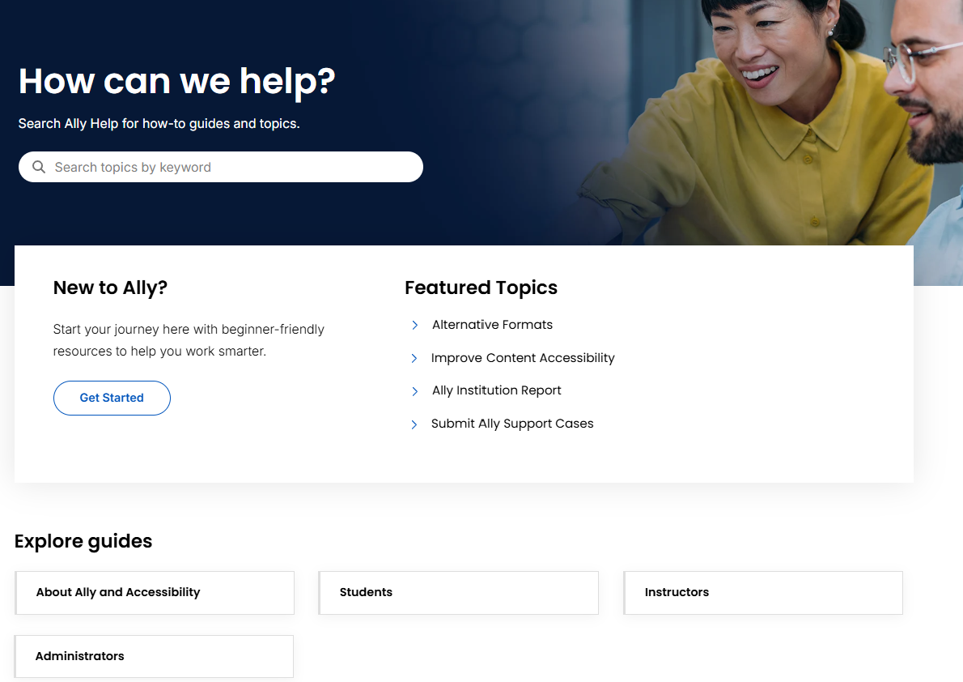
Support for Ally
Visit Ally’s Support Site for more guidance and information: https://help.anthology.com/ally-lms/en/students.html

