Slide 1
Introducing Blackboard Ally to Instructors

Slide 2
Slide Deck Instructions
This slide deck is for deans, department chairs, instructional designers, and any other role that supports faculty in how to use Ally. Feel free to customize the slides to be more relevant to your institution or organization.
Ideal use case for this slide deck is at a department meeting, new faculty orientation, teaching and learning session, or any other similar event.
Any text that is highlighted in yellow should be filled in accordingly.

Slide 3

What is Ally?
Ally is a digital accessibility tool embedded in <insert your Learning Management System name here>, designed to help make digital course content more accessible and inclusive.

Slide 4
Whom does Ally support?
Students
Instructors
Administrators
Provides alternative formats of content.
Provides feedback and guidance to instructors on how to make their digital content accessible.
*Alternative Formats are also available to instructors!
Provides detailed data and insights to help further improve overall course content accessibility at the institution.

Slide 5

Ally’s 3 Key Features for Instructors
Alternative
Formats
Instructor Feedback
Course Accessibility Report
Automatically generated alternative formats of instructor-created or uploaded content, available to ALL students (and instructors!).
Guides instructors on how to improve the accessibility of their course content , helping to generate a change in behavior over time.
Comprehensive accessibility course report that provides guided remediation approaches for instructors.
Notes:
Anthology Ally has 3 main areas of focus features for more inclusive digital experiences for your LMS.
1. Alternative formats helps to deliver inclusive digital experiences to all learners by providing access to content with a range of formats by automatically generating a number of alternatives for the instructor’s original​, like Microsoft Immersive Reader as an alternative format inside Ally and translated versions into more than 75 different languages.
2. Instructor Feedback improves the accessibility of their course content faster and create fully accessible content every day with best practices in place. Ally automatically checks and scores accessibility issues in real-time, providing detailed guidance on to fix them through built-in feedback that helps improve quality and usability of digital content and generate a change in behavior over time. Ally’s accessibility checklist is based on WCAG 2.2 AA (Web Content Accessibility Guidelines). This is an international accessibility standard, and most of the new legislation and legal requirements worldwide aligns with this standard.
Features like:
WYSIWYG – What You See is What You Get reduces the time it takes to make changes to course content, allowing instructors and content creators to be proactive instead of reactive in content creation as accessibility is improved.
AI Alternative Text Assistant feature leverages AI capabilities to automatically generate suggestions for alternative text for images helping instructors save significant time by streamlining the image description process and making it faster and more efficient. However, the instructor would still have full control to modify the suggested alternative text to check accuracy as the description should be approved before saving it to the related image.
3. Institutional and Course Reporting allows to have a wider view of accessibility issues to see how your institution is performing and how things are evolving from an accessibility standpoint with institutional reporting. The institutional report helps build understanding of how things are going, and can help identify what you can do as an institution to further improve things.

Slide 6
Alternative Formats

Slide 7
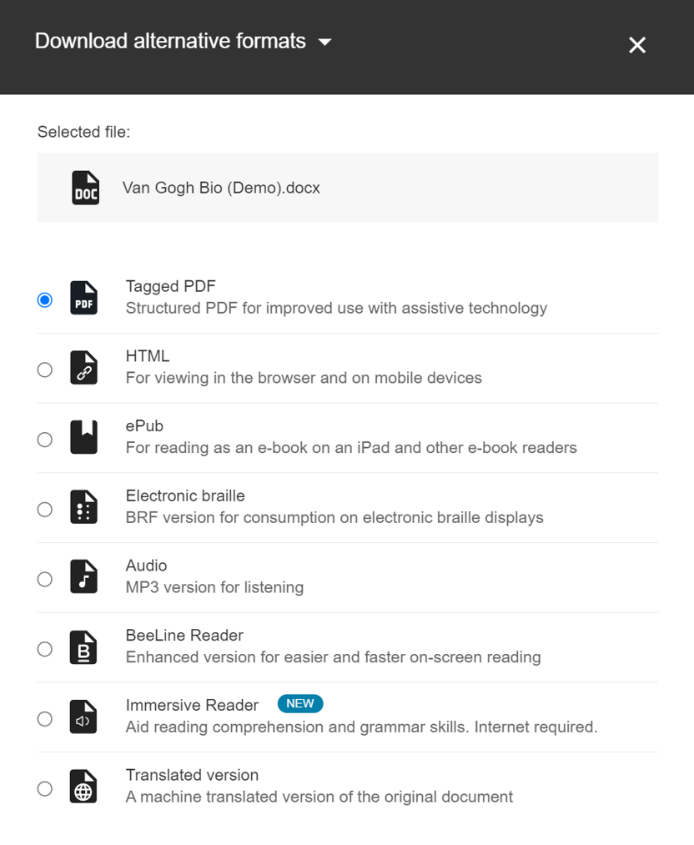
Alternative Formats Overview
Automatically generated alternative formats of instructor-uploaded and created content, providing students with multiple options for engagement
Provides students with autonomy
Supports different learner needs, preferences, abilities, and devices
Also available to instructors

Slide 8
Available Alternative Formats
  OCR’d PDF
  Tagged PDF
  ePub
  Audio
  Translated version
  BeeLine Reader
  Braille
  Microsoft Immersive Reader
  HTML

Slide 9
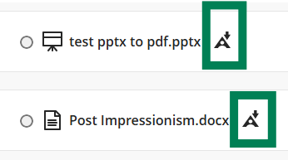
How to Access the Alternative Formats
Look for the Alternative Formats icon to the right of your course content. Once you select the icon, a menu of available alternative formats based on the original content will appear. Select your desired alternative format and then download.
The Alternative Formats icon can vary by LMS, but it generally appears as a downward-pointing arrow.
If you don't see an Alternative Formats icon next to a piece of content, Ally may not be enabled for that content or the file type may not support Alternative Formats.

Slide 10
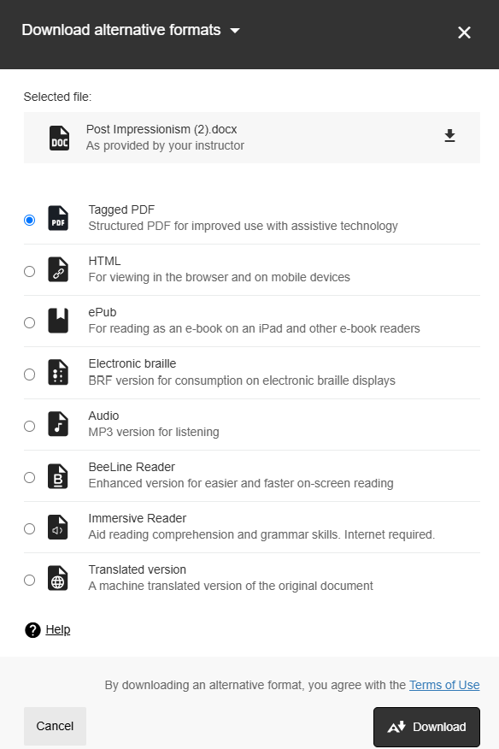
Downloading Alternative Formats
After you’ve selected the content item you wish to download an alternative format for, you will be brought to a menu of available options.
Select the alternative format you wish to download and then select download.

Slide 11
Instructor Feedback

Slide 12




What is Instructor Feedback?
Feedback on an individual file or content item that includes the following:
  accessibility score
  list of all accessibility issues detected
  context and guidance on fixing detected issues (what, why, how

Slide 13




Accessibility Indicators
Low (0 - 33%)
Medium (34-66%)
High (67-99%)
Perfect (100%)
Needs help! There are severe accessibility issues.
A little better. The file is somewhat accessible but needs improvement.
Almost there. The file is accessible, but more improvements are possible.
Ally didn't identify any accessibility issue, but further improvements may still be possible.
Accessibility indicator is never visible to students.
Weighted average of results, based on W3C research

Slide 14
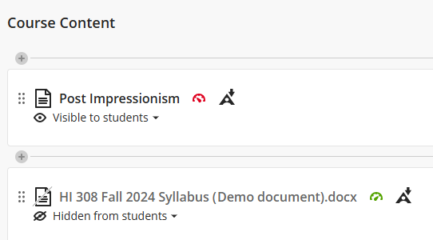
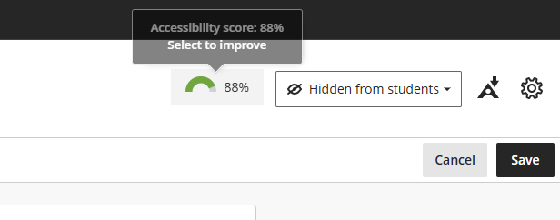
How to Access Instructor Feedback
Find the content item and select the Alternative Format icon to the right of the item.
  Icon and layout may vary depending on your LMS
Choose an alternative format from the menu
Download your selected format
To access Instructor Feedback for WYSIWYG (content built directly in your LMS), you will need to go into editing mode.

Slide 15
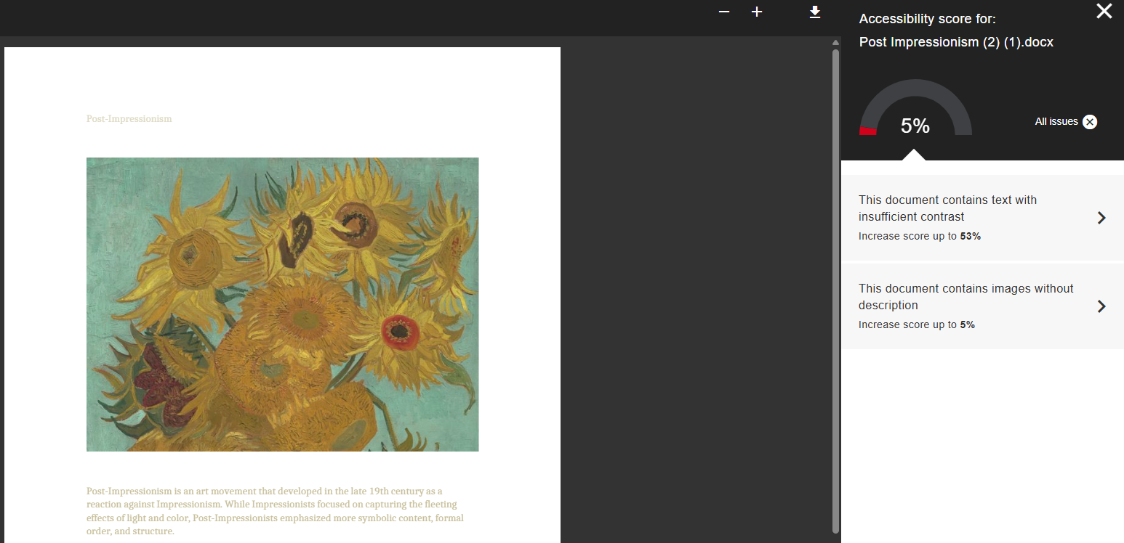
How to Access the Instructor Feedback Panel
Select the accessibility indicator to open the Instructor Feedback panel, where all detected accessibility issues are listed along with guidance and recommended steps for remediation.

Slide 16
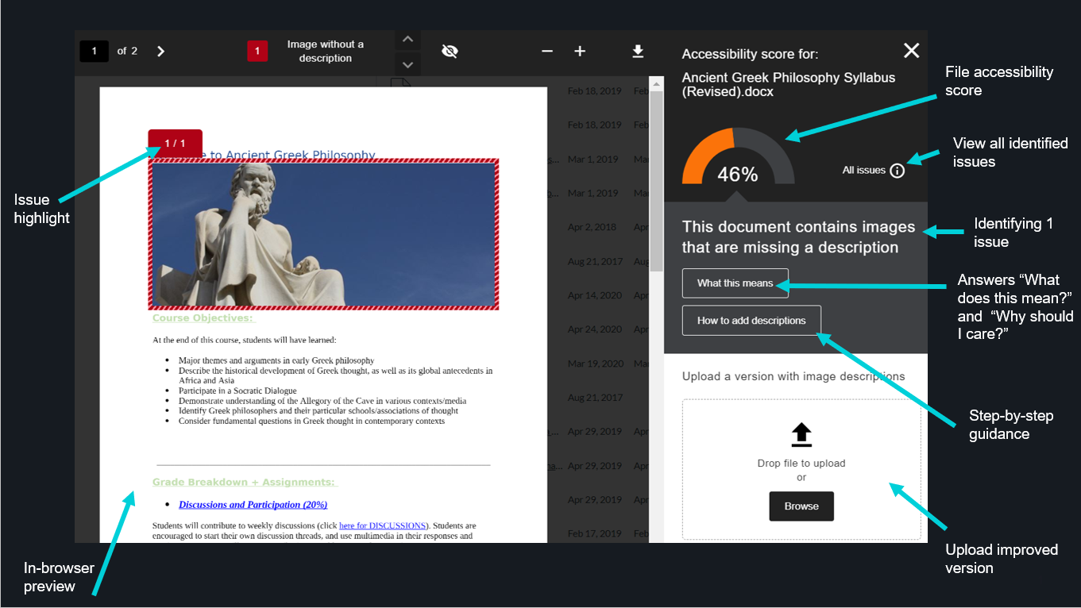
Instructor Feedback Breakdown

Slide 17
Course Accessibility Report

Slide 18
Course Accessibility Report Overview
Faculty-facing report that provides accessibility summary at the course level
    complements accessibility indicators in IF
Helps with prioritizing content remediation efforts by providing 3 guided remediation approaches:
    Content with easiest issues to fix
    Fix Low Scoring Content
    List of files with a specific accessibility issue
IF can be triggered from the CAR

Slide 19
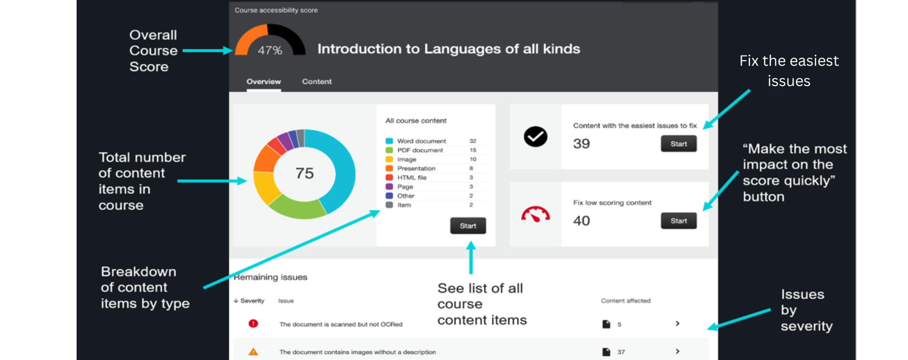
Course Accessibility Report Breakdown

Slide 20
How to Access your Course Location Report
The location of your report will depend on which LMS your institution uses. Please see the list below.
  Blackboard Learn Original Course View: Course Tools
  Blackboard Learn Ultra Course View: Books & Course Tools
  Moodle: Course Dashboard
  Instructure Canvas: Course left navigation bar
  D2L Brightspace: Course Navbar
See how the Course Accessibility Report looks in your course.

Slide 21
Resources & Support

Slide 22
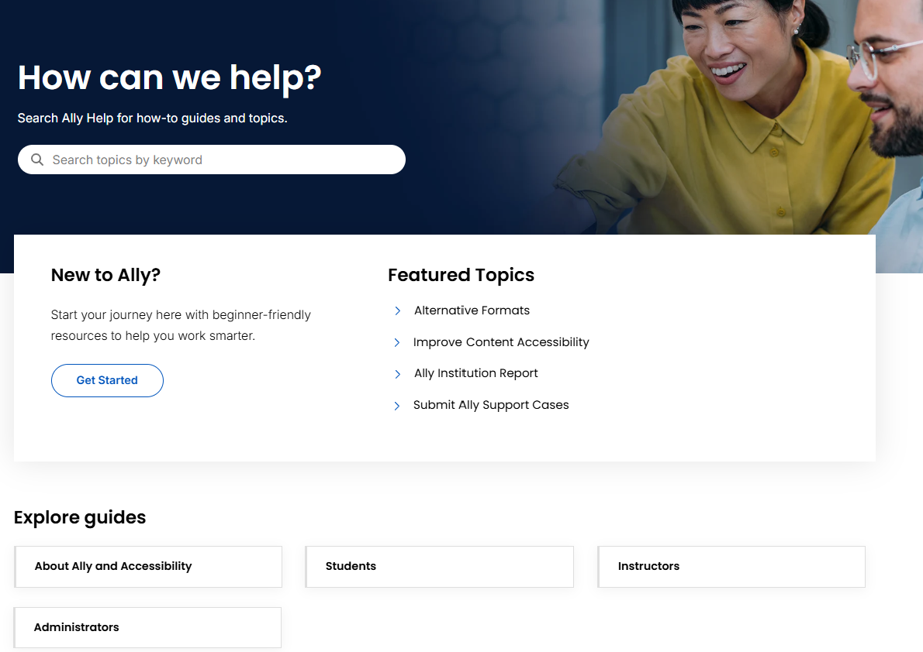
Support for Ally
Visit Ally’s Support Site for more guidance and information: Ally Support for Instructors

Slide 23
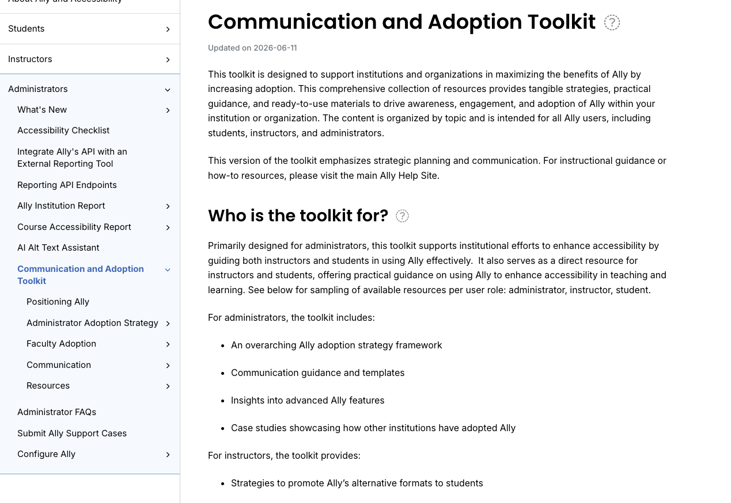
Ally’s Communication & Adoption Toolkit
Ally Communication & Adoption Toolkit: collection of resources for administrators & faculty to drive Ally adoption
  Includes comprehensive adoption strategy guide, customizable communication templates, syllabus statements, and more!
Ally Communication & Adoption
Toolkit

Slide 24
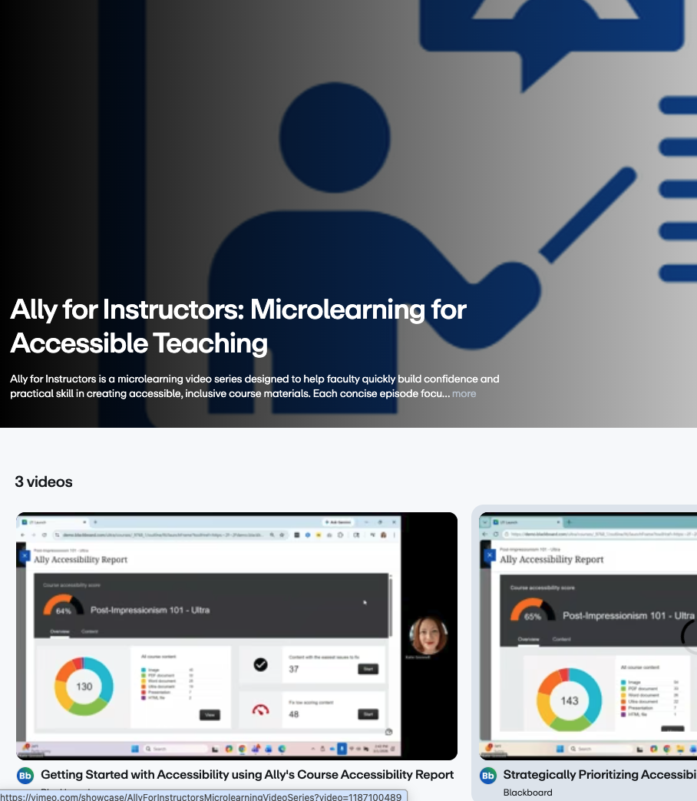
Ally for Instructors: Microlearning Video Series
  New video series focused on helping faculty build practical, confidence‑boosting accessibility skills with Ally.
  Real‑world examples instructors can apply immediately
  New video on PDF Accessibility Challenges for Instructors & Learners
  Ally for Instructors Microlearning Video Series

Slide 25
Connect with Us!
Ally User Group Meetings
Ally User Group Community
Idea Exchange
Join one of our monthly Ally Office Hours to ask questions about Ally, receive updates on product releases and content, and connect with Ally users from across the glob.
Meetings occur the second Monday of every month
Blackboard Ally Office Hours Registration Page
Engage in the Ally User Group Community online and join in on meetings!
Meetings occur on the 3rd Thursday every other month.
Ally User Group (in the Blackboard Community)
Share Your Product Ideas!
https://www.blackboard.com/idea-exchange

